Slide 1

Convolutional Networks in 1D or 3D
1D and 3D generalizations of models
deeplearning.ai

Slide 2
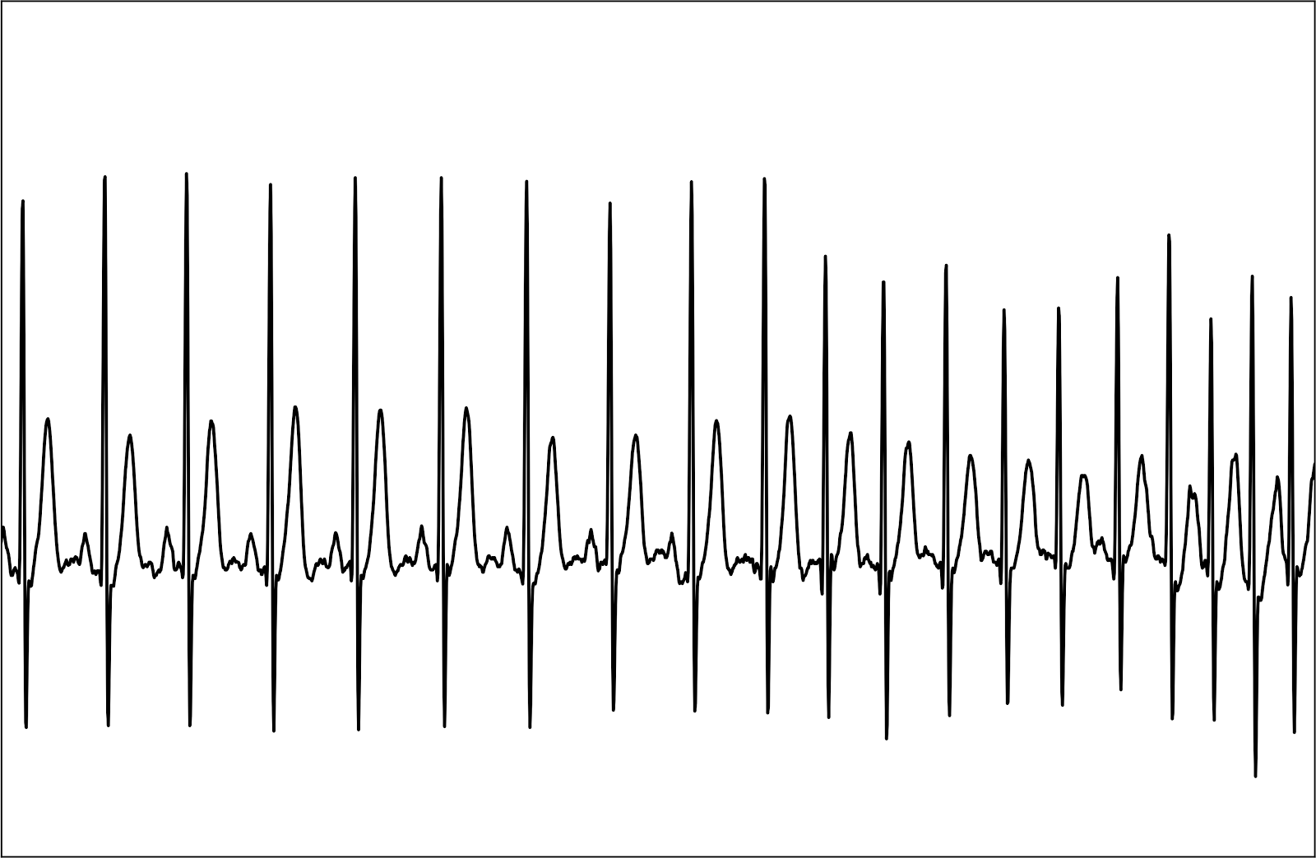





Convolutions in 2D and 1D
$$∗$$
2D filter
$$5×5$$
2D input image
$$14×14$$
$$∗$$
1 | 20 | 15 | 3 | 18 | 12 | 4 | 17
1 | 3 | 10 | 3 | 1

Slide 3
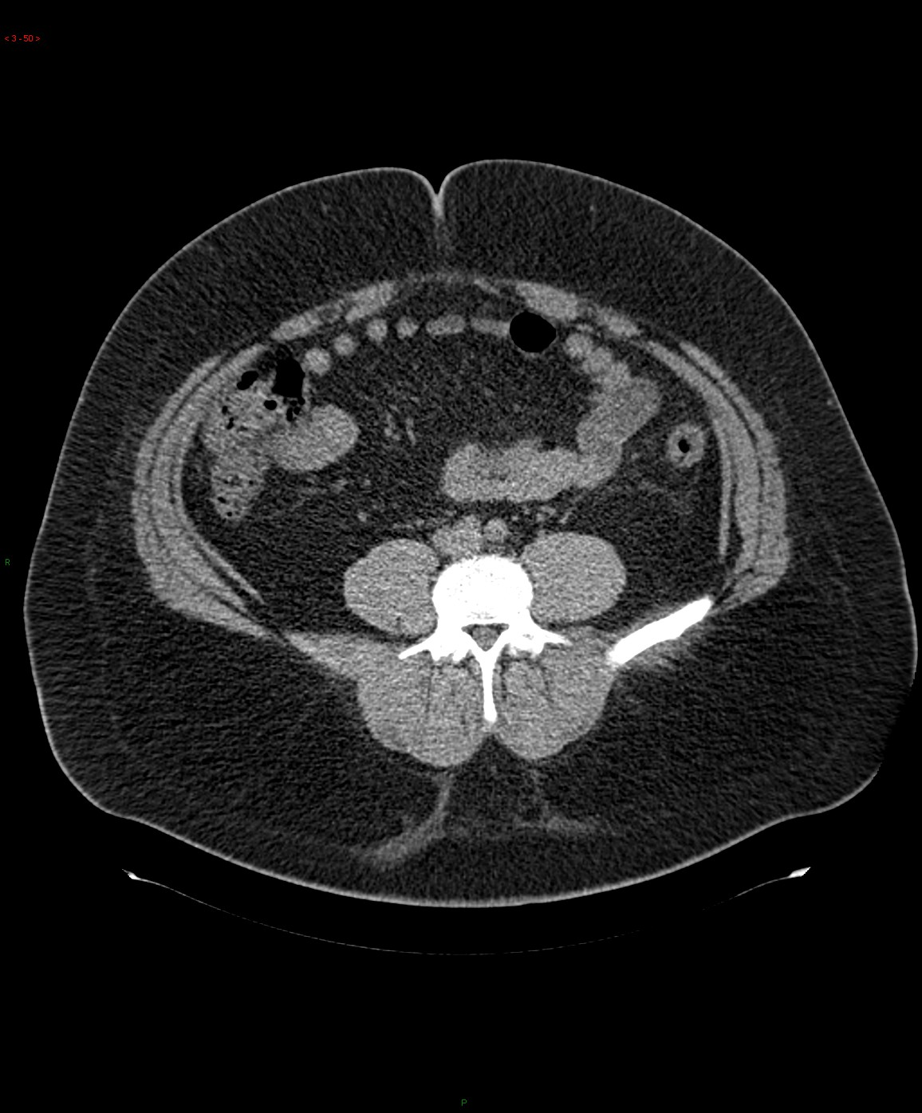
3D data
Andrew Ng

Slide 4
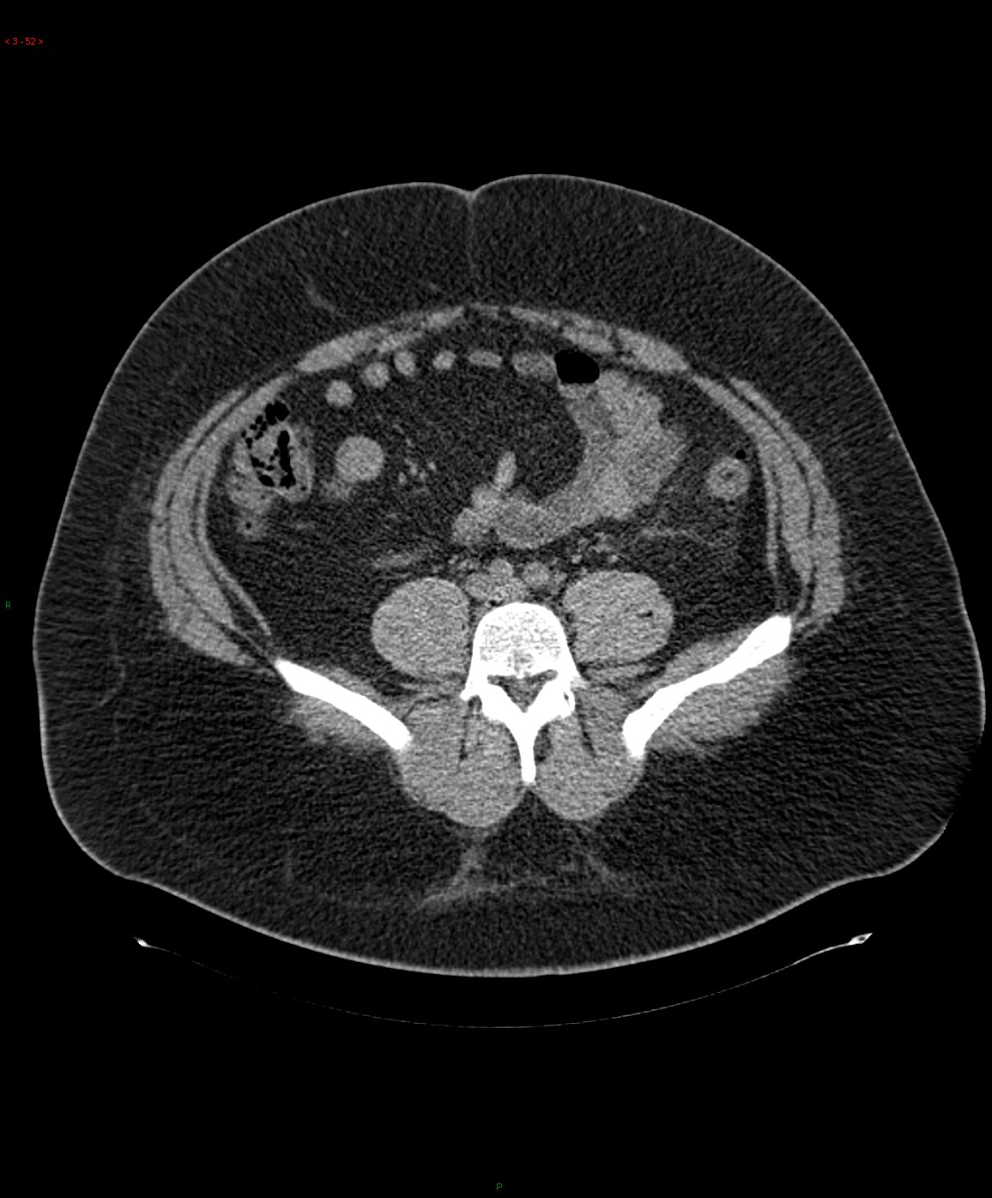
3D data
Andrew Ng

Slide 5
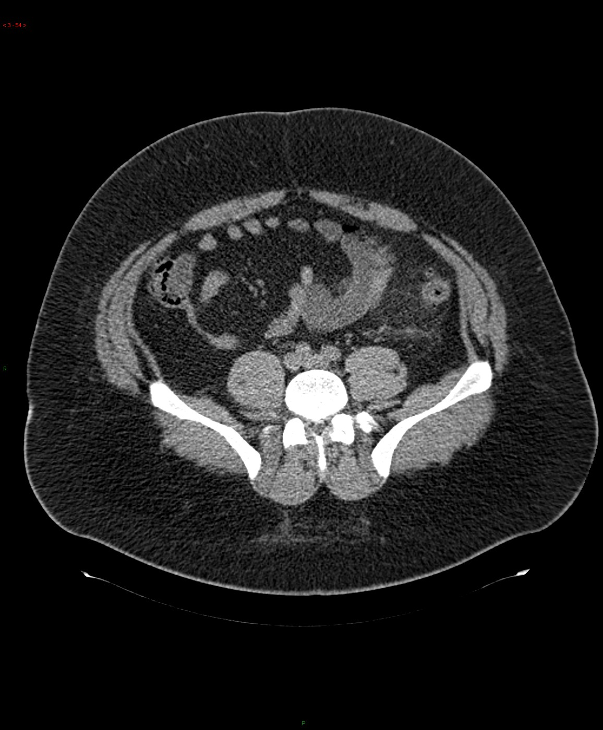
3D data
Andrew Ng

Slide 6
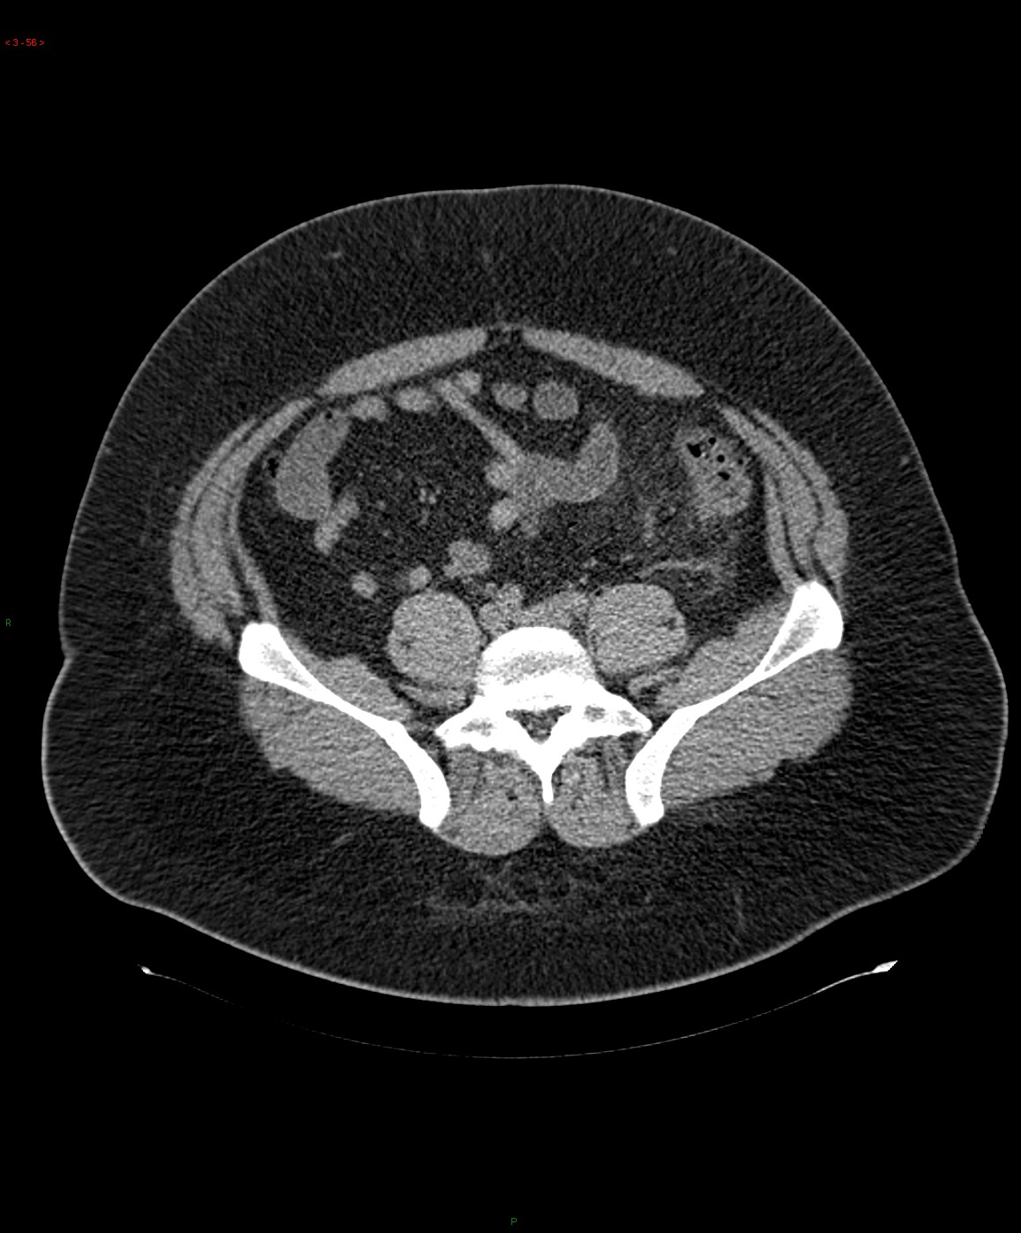
3D data
Andrew Ng

Slide 7
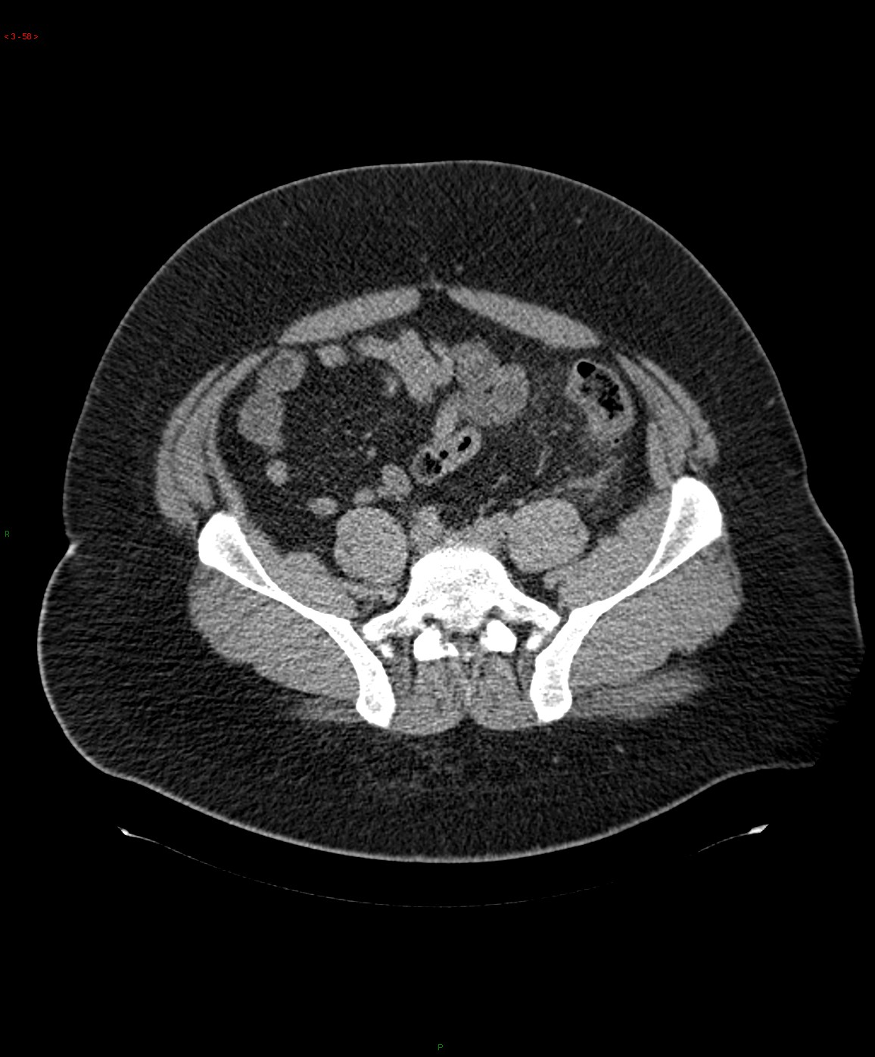
3D data
Andrew Ng

Slide 8
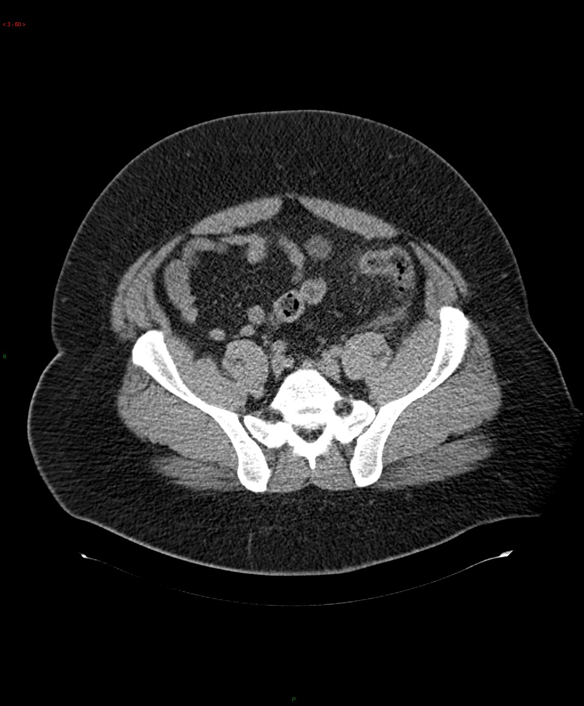
3D data
Andrew Ng

Slide 9
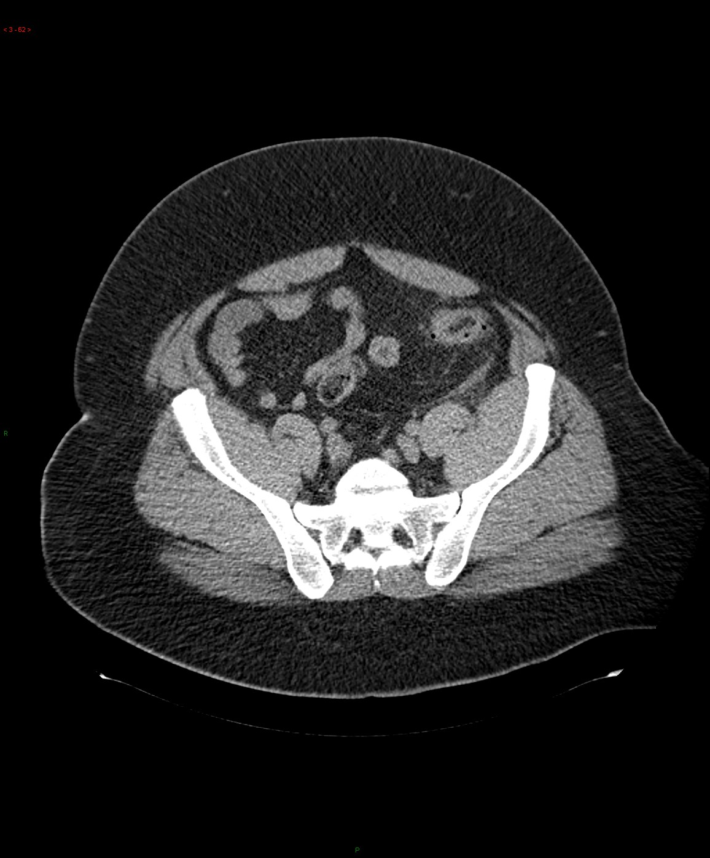
3D data
Andrew Ng

Slide 10
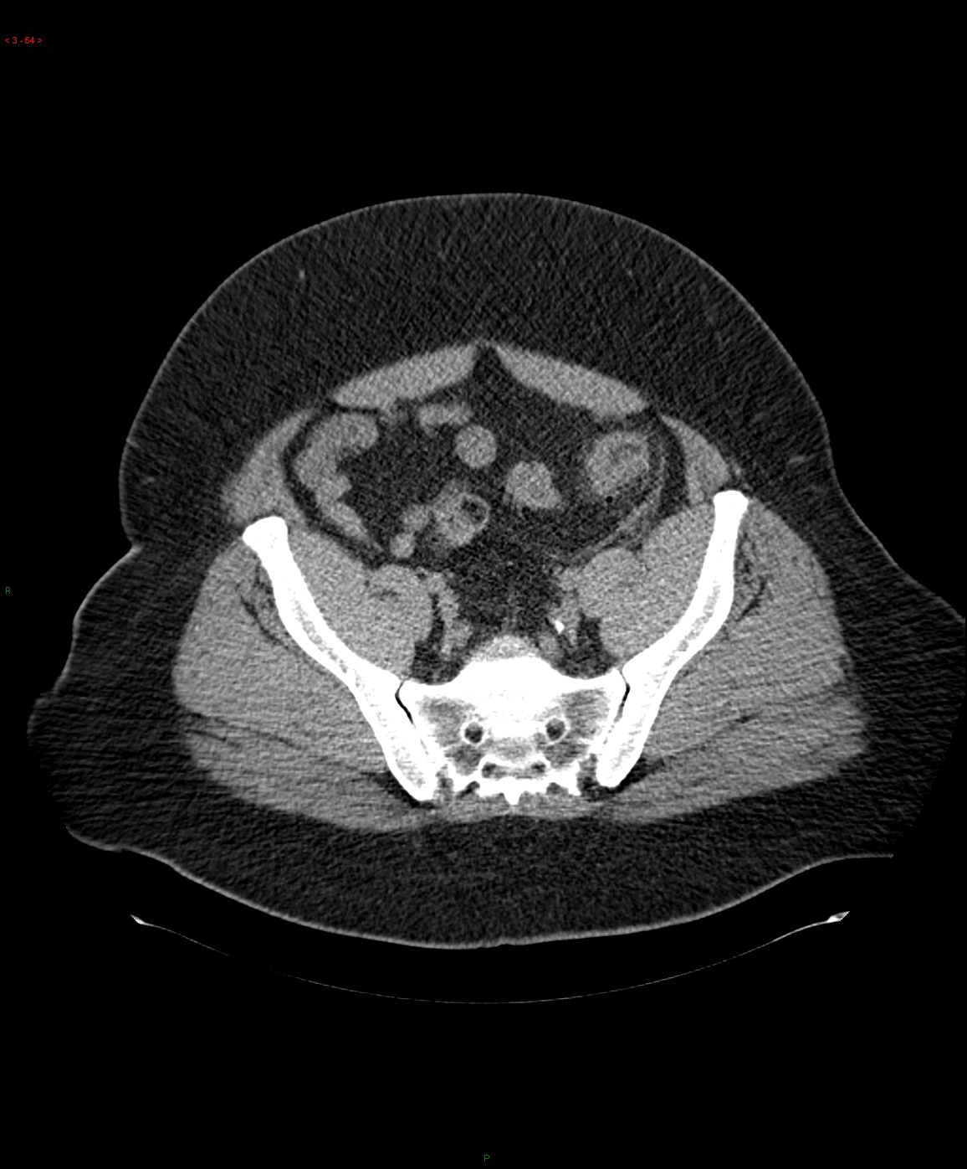
3D data
Andrew Ng

Slide 11
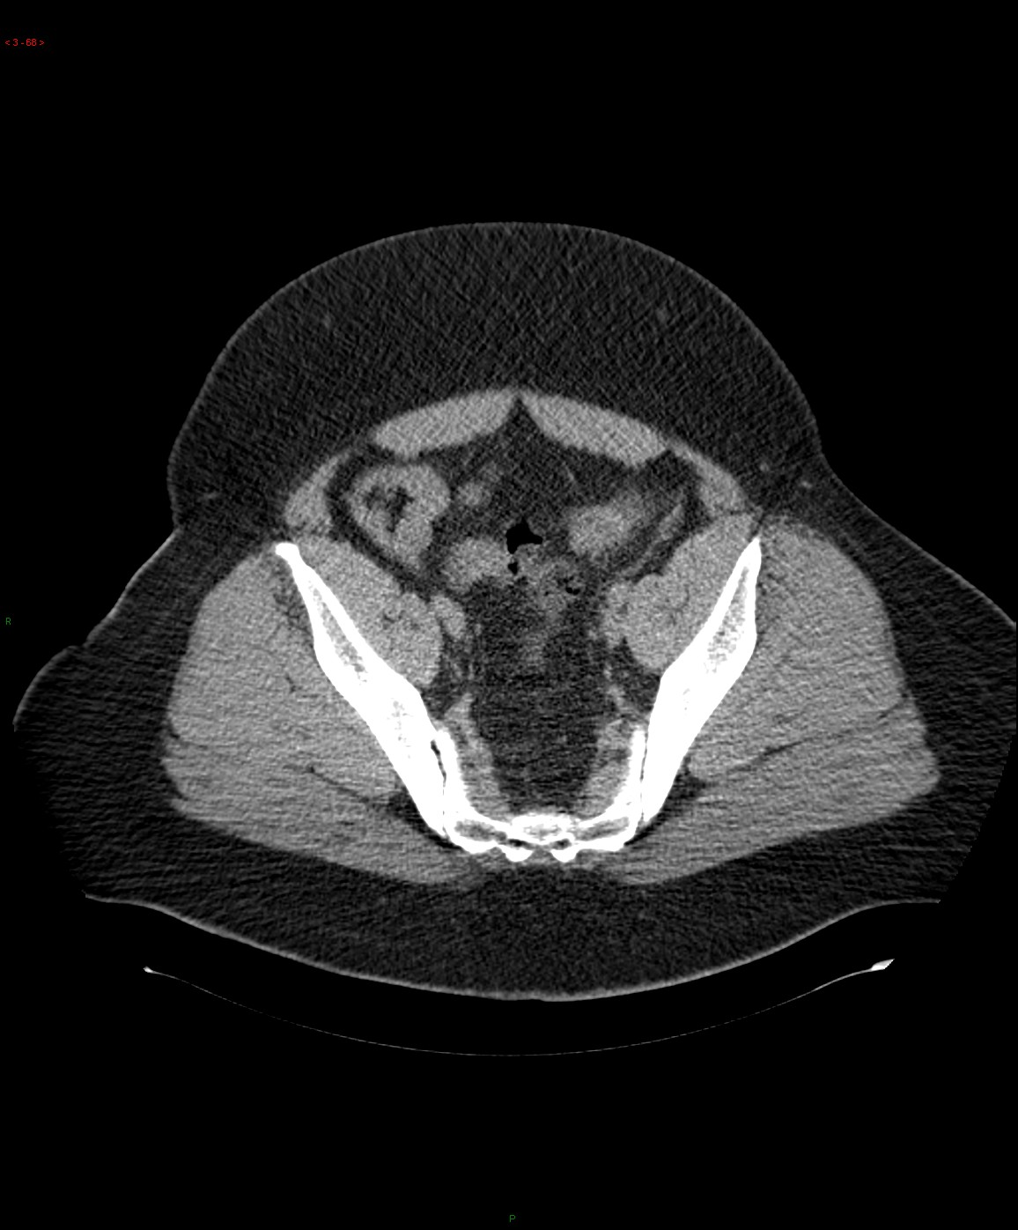
3D data
Andrew Ng

Slide 12
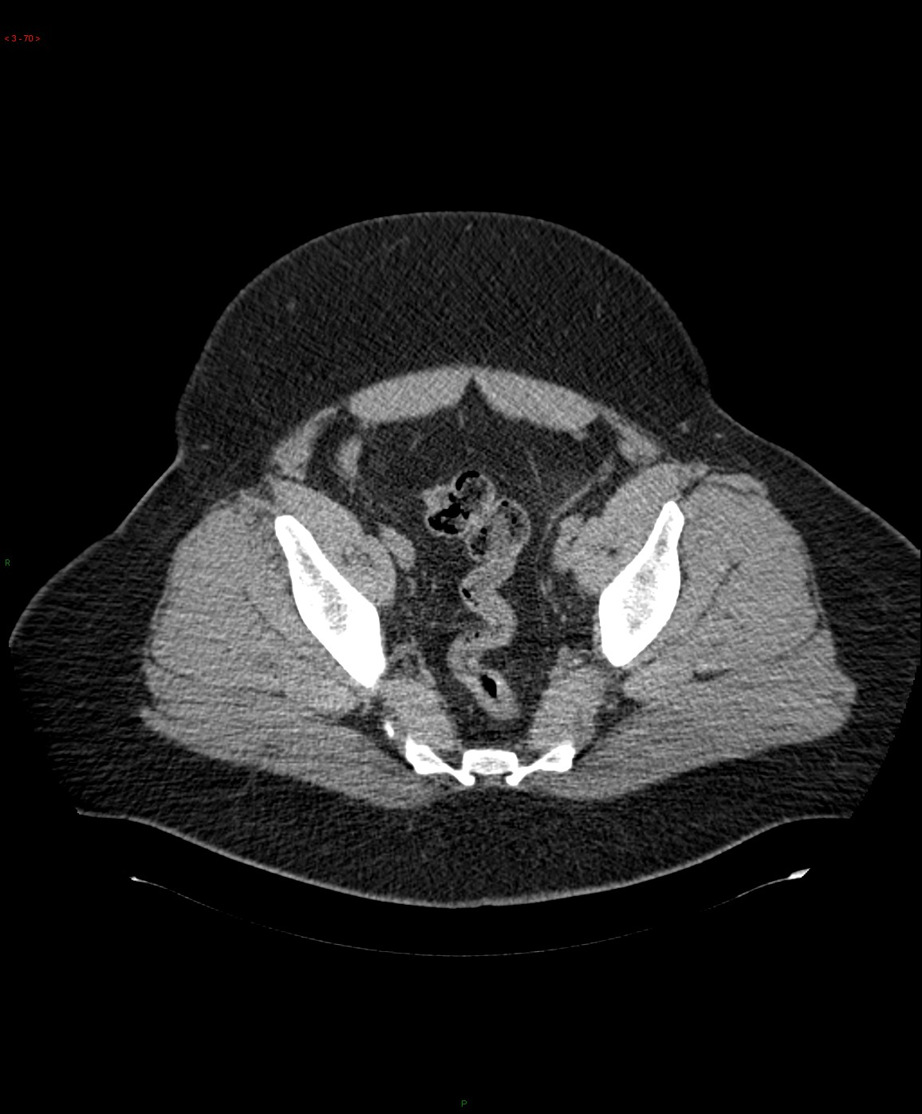
3D data
Andrew Ng

Slide 13
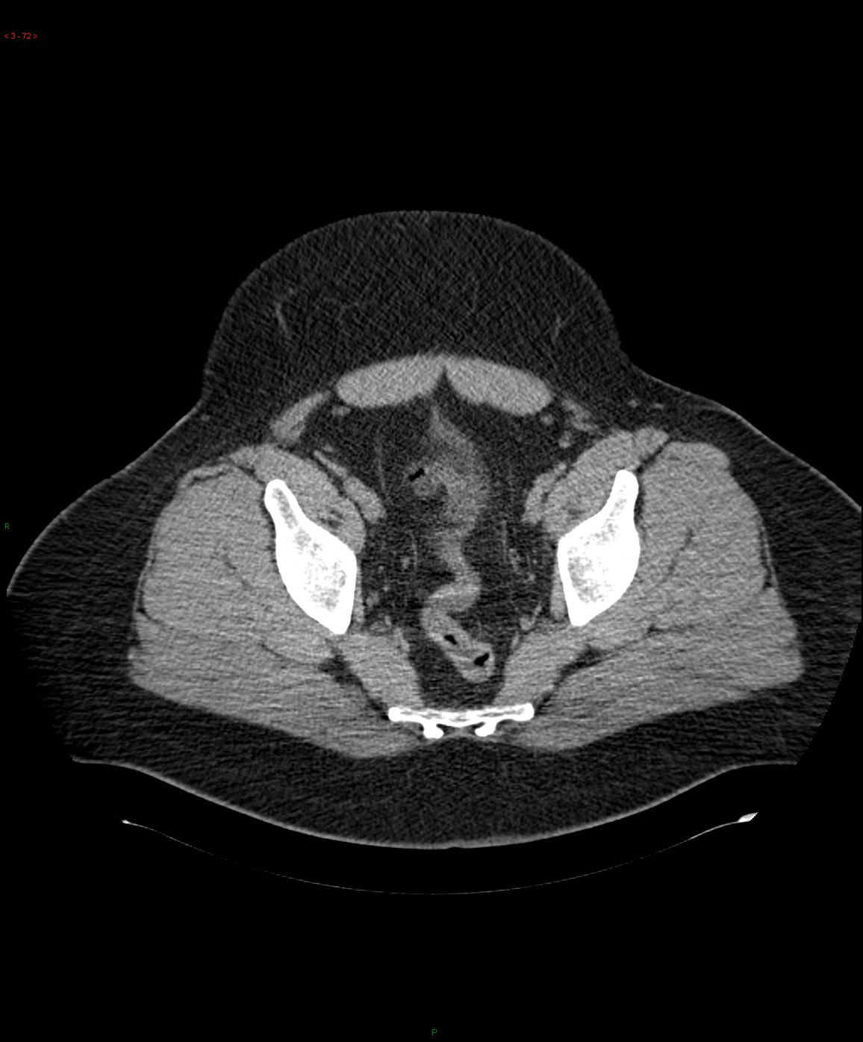
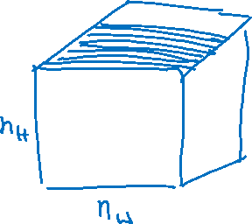
3D data
Andrew Ng

Slide 14
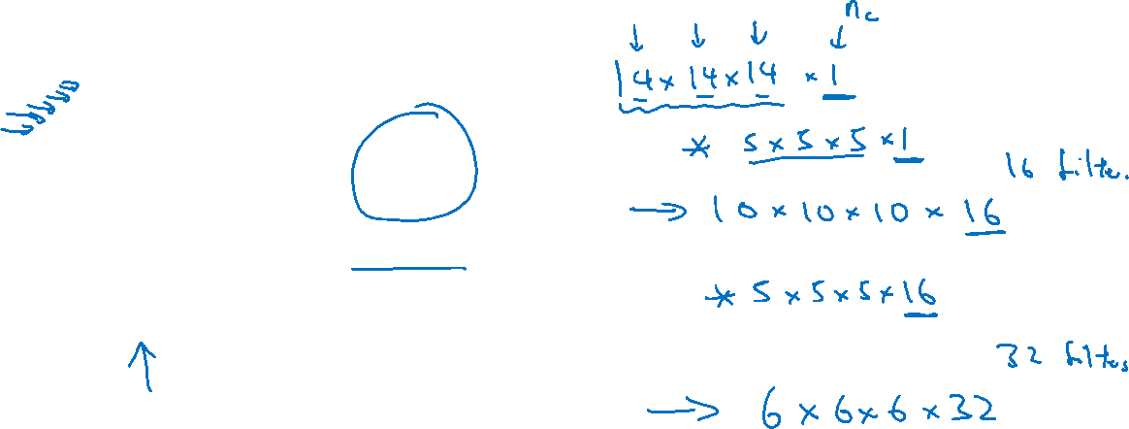

3D convolution
$$∗$$
3D filter
3D volume

